Slide 1

HOME
INTRO
FUNCTION
DIFFICULTY
DEMO
Super Campus
SUPER CAMPUS
PRESENT BY --- 吕炎明(Leader)
刘慧杰, 刘宇轩, 林业滨, 吴伯泽, 吴昊蔚

Slide 2
TABLE OF CONTENTS
INTRODUCE
01
SUPER CAMPUS
FUNCTION
02
DIFFICULTY
03
VIDEO PRENSENT
04
HOME
INTRO
FUNCTION
DIFFICULTY
DEMO

Slide 3
SUPER CAMPUS
01
APP INTRO
HOME
INTRO
FUNCTION
DIFFICULTY
DEMO

Slide 4
INTRO
SUPER CAMPUS
HOME
INTRO
FUNCTION
DIFFICULTY
DEMO
IDEA
01
Develop a campus life app that integrates multiple functions
02
CLIENT
Campus student
INNOVATION
03
Integrated community sharing, lost and found, and curriculum functions

Slide 5
SUPER CAMPUS
02
APP FUNCTION
HOME
INTRO
FUNCTION
DIFFICULTY
DEMO

Slide 6
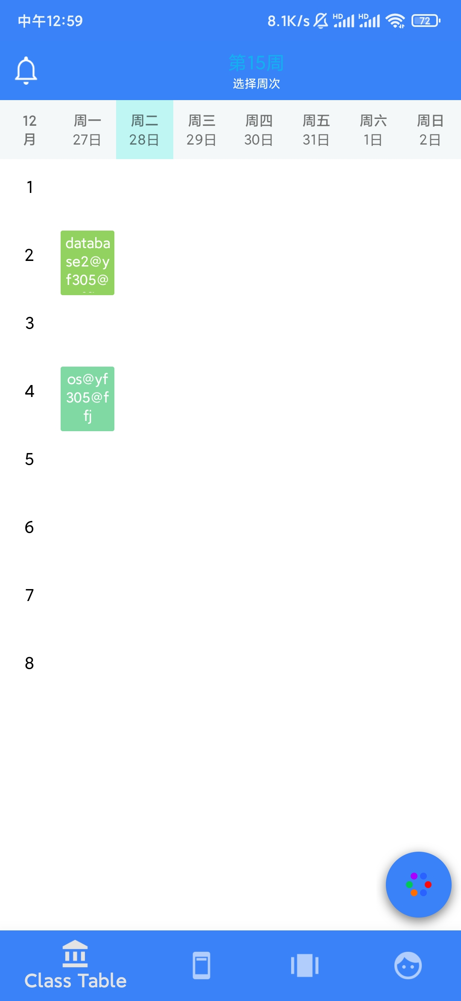
CLASS SCHEDULE
SUPER CAMPUS
HOME
INTRO
FUNCTION
DIFFICULTY
DEMO
Connect to the school's database
Custom class schedule.
Real-time show your own course information.
Addition, deletion, modification and query of course information.

Slide 7
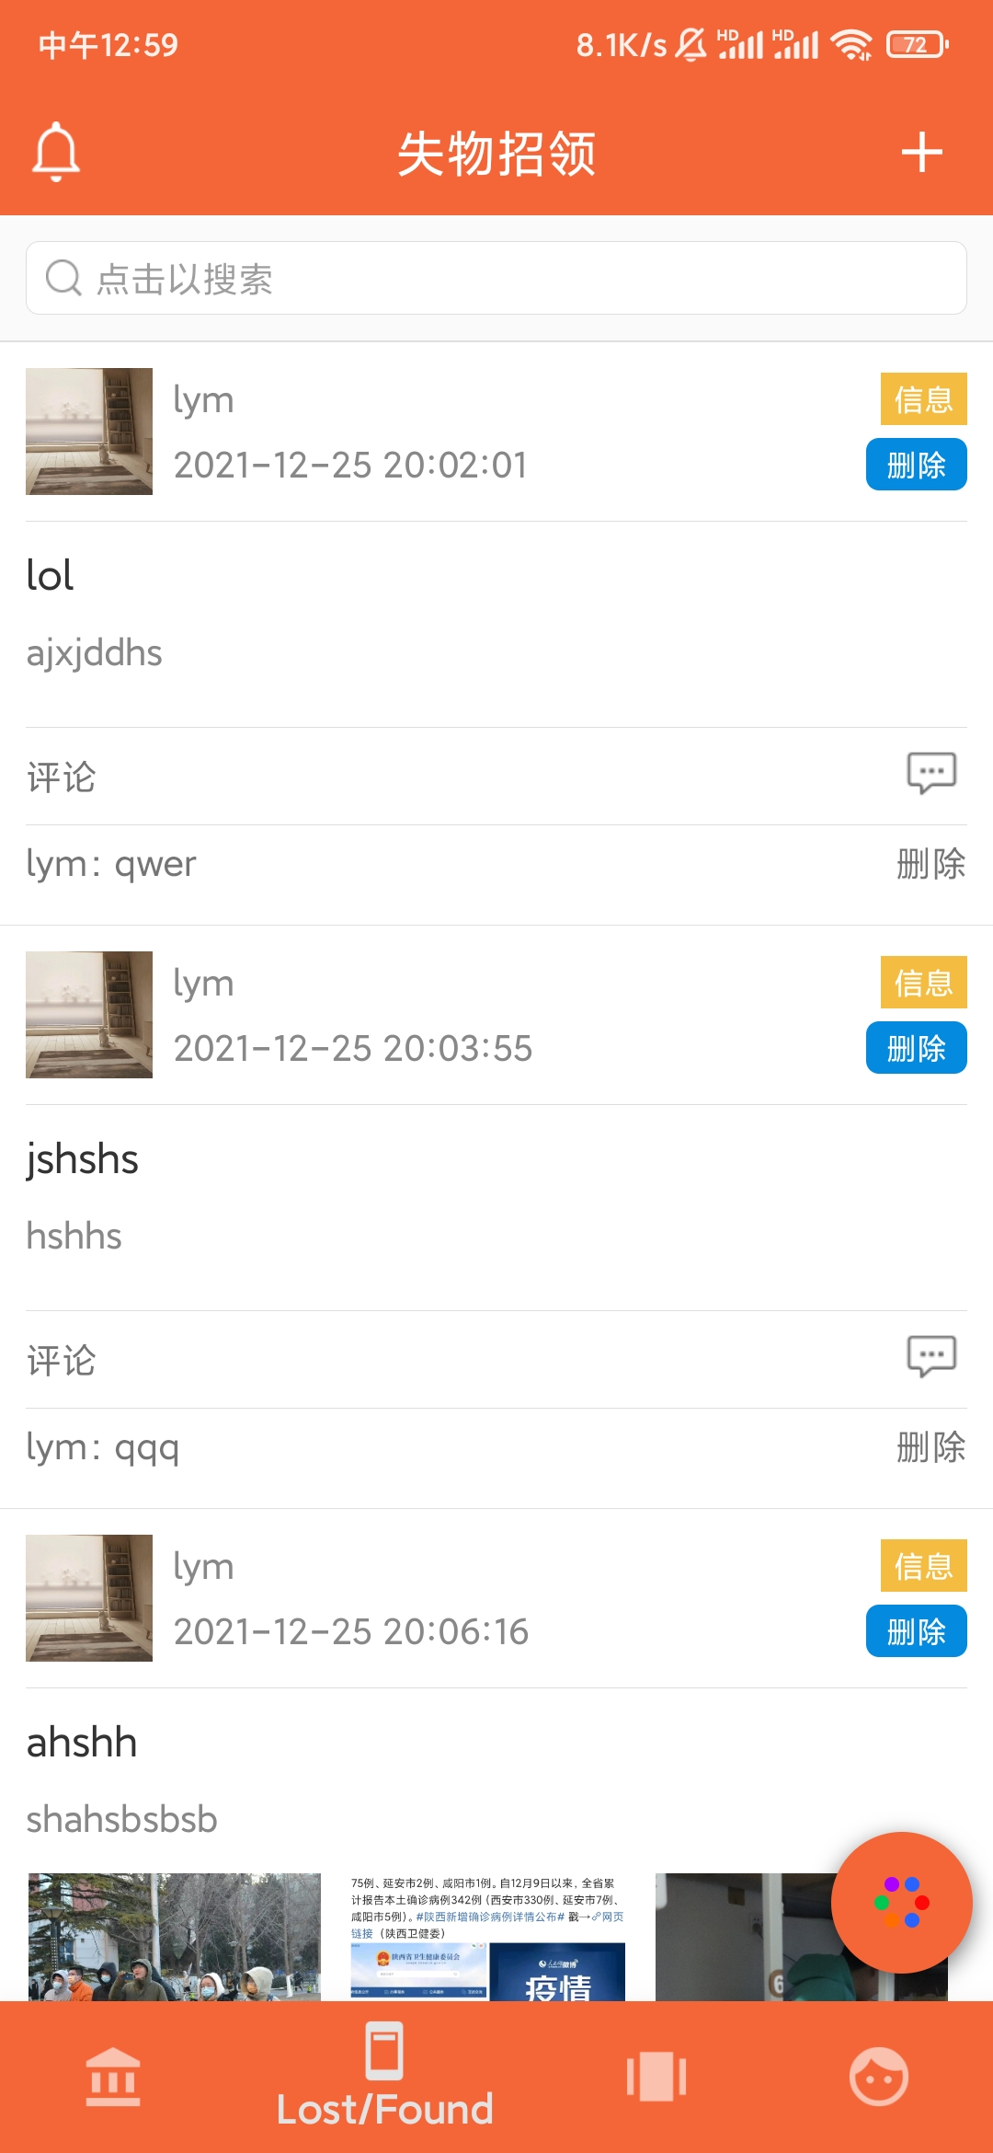
LOST AND FOUD
SUPER CAMPUS
HOME
INTRO
FUNCTION
DIFFICULTY
DEMO
Share or query lost and found information on your campus.
Comment, like and sharing function.
Integrated object recognition, which can identify common lost items.

Slide 8
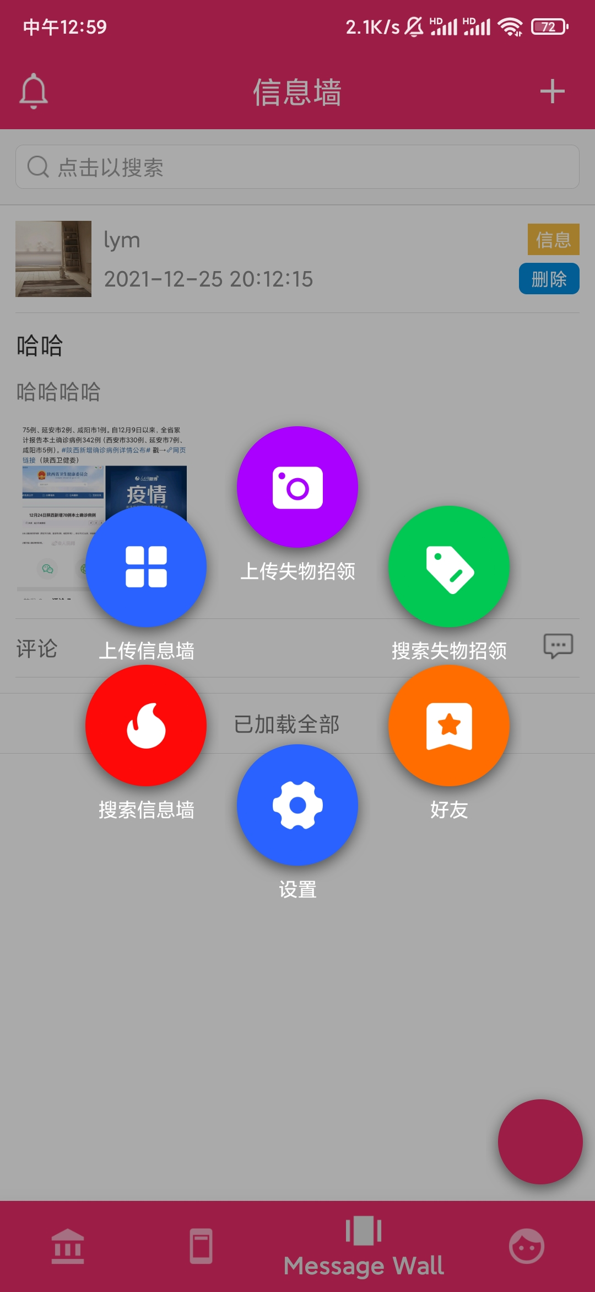
MESSAGE WALL
SUPER CAMPUS
HOME
INTRO
FUNCTION
DIFFICULTY
DEMO
Share your campus life with others.
Comment, like and sharing function.
Integrated object recognition.

Slide 9
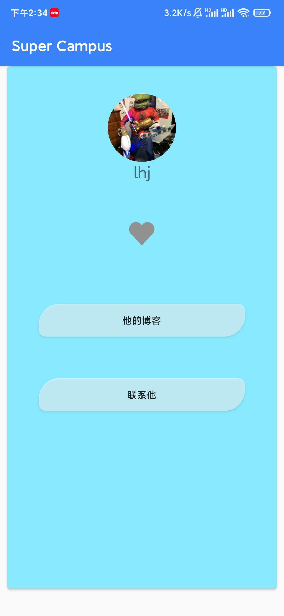
FRIENDS
SUPER CAMPUS
HOME
INTRO
FUNCTION
DIFFICULTY
DEMO
Share your campus life with others.
Comment, like and sharing function.
Watch your friends activities and information.

Slide 10
SUPER CAMPUS
03
DIFFICULTY
HOME
INTRO
FUNCTION
DIFFICULTY
DEMO

Slide 11
SUPER CAMPUS
DIFFICULTIES DURING DEVELOPMENT
HOME
INTRO
FUNCTION
DIFFICULTY
DEMO

Slide 12
DIFFICULTIES DURING DEVELOPMENT
SUPER CAMPUS
HOME
INTRO
FUNCTION
DIFFICULTY
DEMO
When developing the project, we encountered the following problems:
The existing software related functions are relatively complete
Object recognition accuracy is too low
Front and back end docking is complicated
Realization of component animation effects

Slide 13
SUPER CAMPUS
OUR SOLUTIONS
HOME
INTRO
FUNCTION
DIFFICULTY
DEMO

Slide 14
OUR SOLUTIONS
SUPER CAMPUS
HOME
INTRO
FUNCTION
DIFFICULTY
DEMO
Here’s our solution for those problem:
The existing software related functions are relatively complete
Integrate related functions into our products.
Object recognition accuracy is too low
Based on ssd_mobilenet_v1_coco data set, add data for easy-to-lost items to train the model. whose binary file is small so the recognition speed is the fastest, and the recognition rate was improved, it is enough to recognize easily lost objects.
Front and back end docking is complicated
Adjust the back-end service according to the front-end interface
Realization of component animation effects
Learn how to achieve Android animation effects and use existing components flexibly

Slide 15
SUPER CAMPUS
BACK END TECH
HOME
INTRO
FUNCTION
DIFFICULTY
DEMO

Slide 16
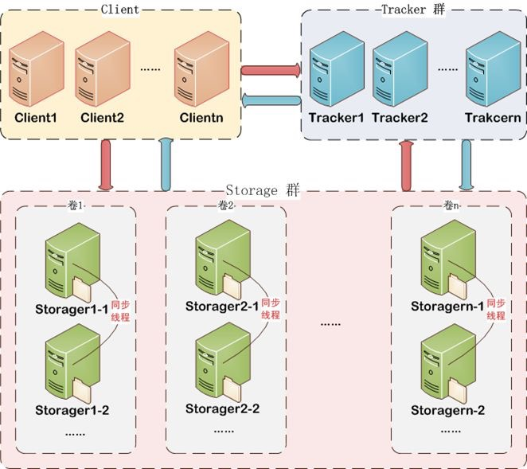
BACK END TECH
SUPER CAMPUS
HOME
INTRO
FUNCTION
DIFFICULTY
DEMO
FastDFS is an open source high performance distributed file system. It's major functions include: file storing, file syncing and file accessing (file uploading and file downloading), and it can resolve the high capacity and load balancing problem. FastDFS should meet the requirement of the website whose service based on files such as photo sharing site and video sharing site.

Slide 17
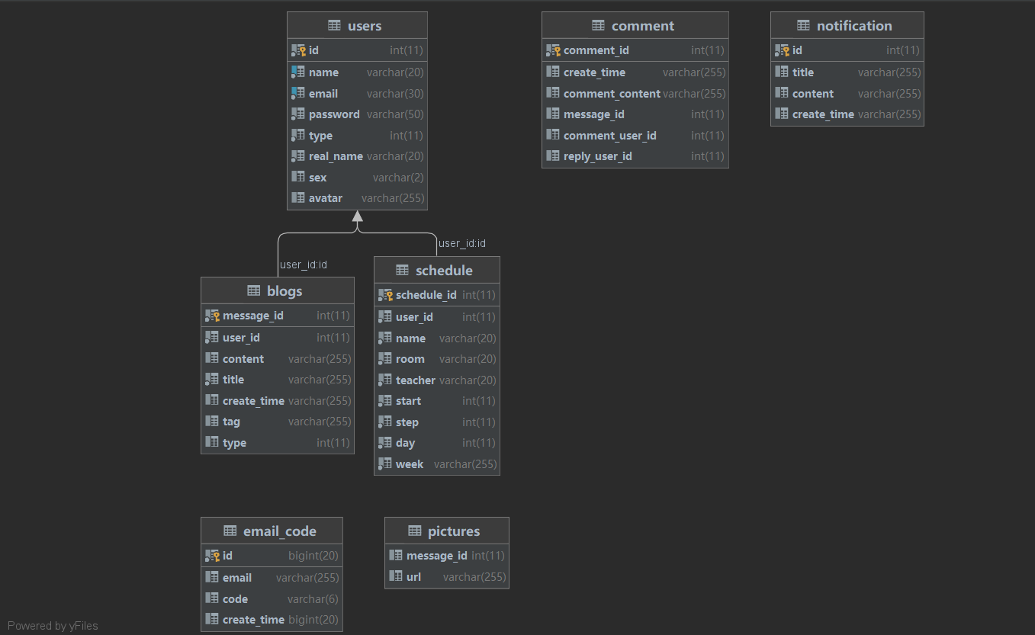
BACK END TECH
SUPER CAMPUS
HOME
INTRO
FUNCTION
DIFFICULTY
DEMO

Slide 18
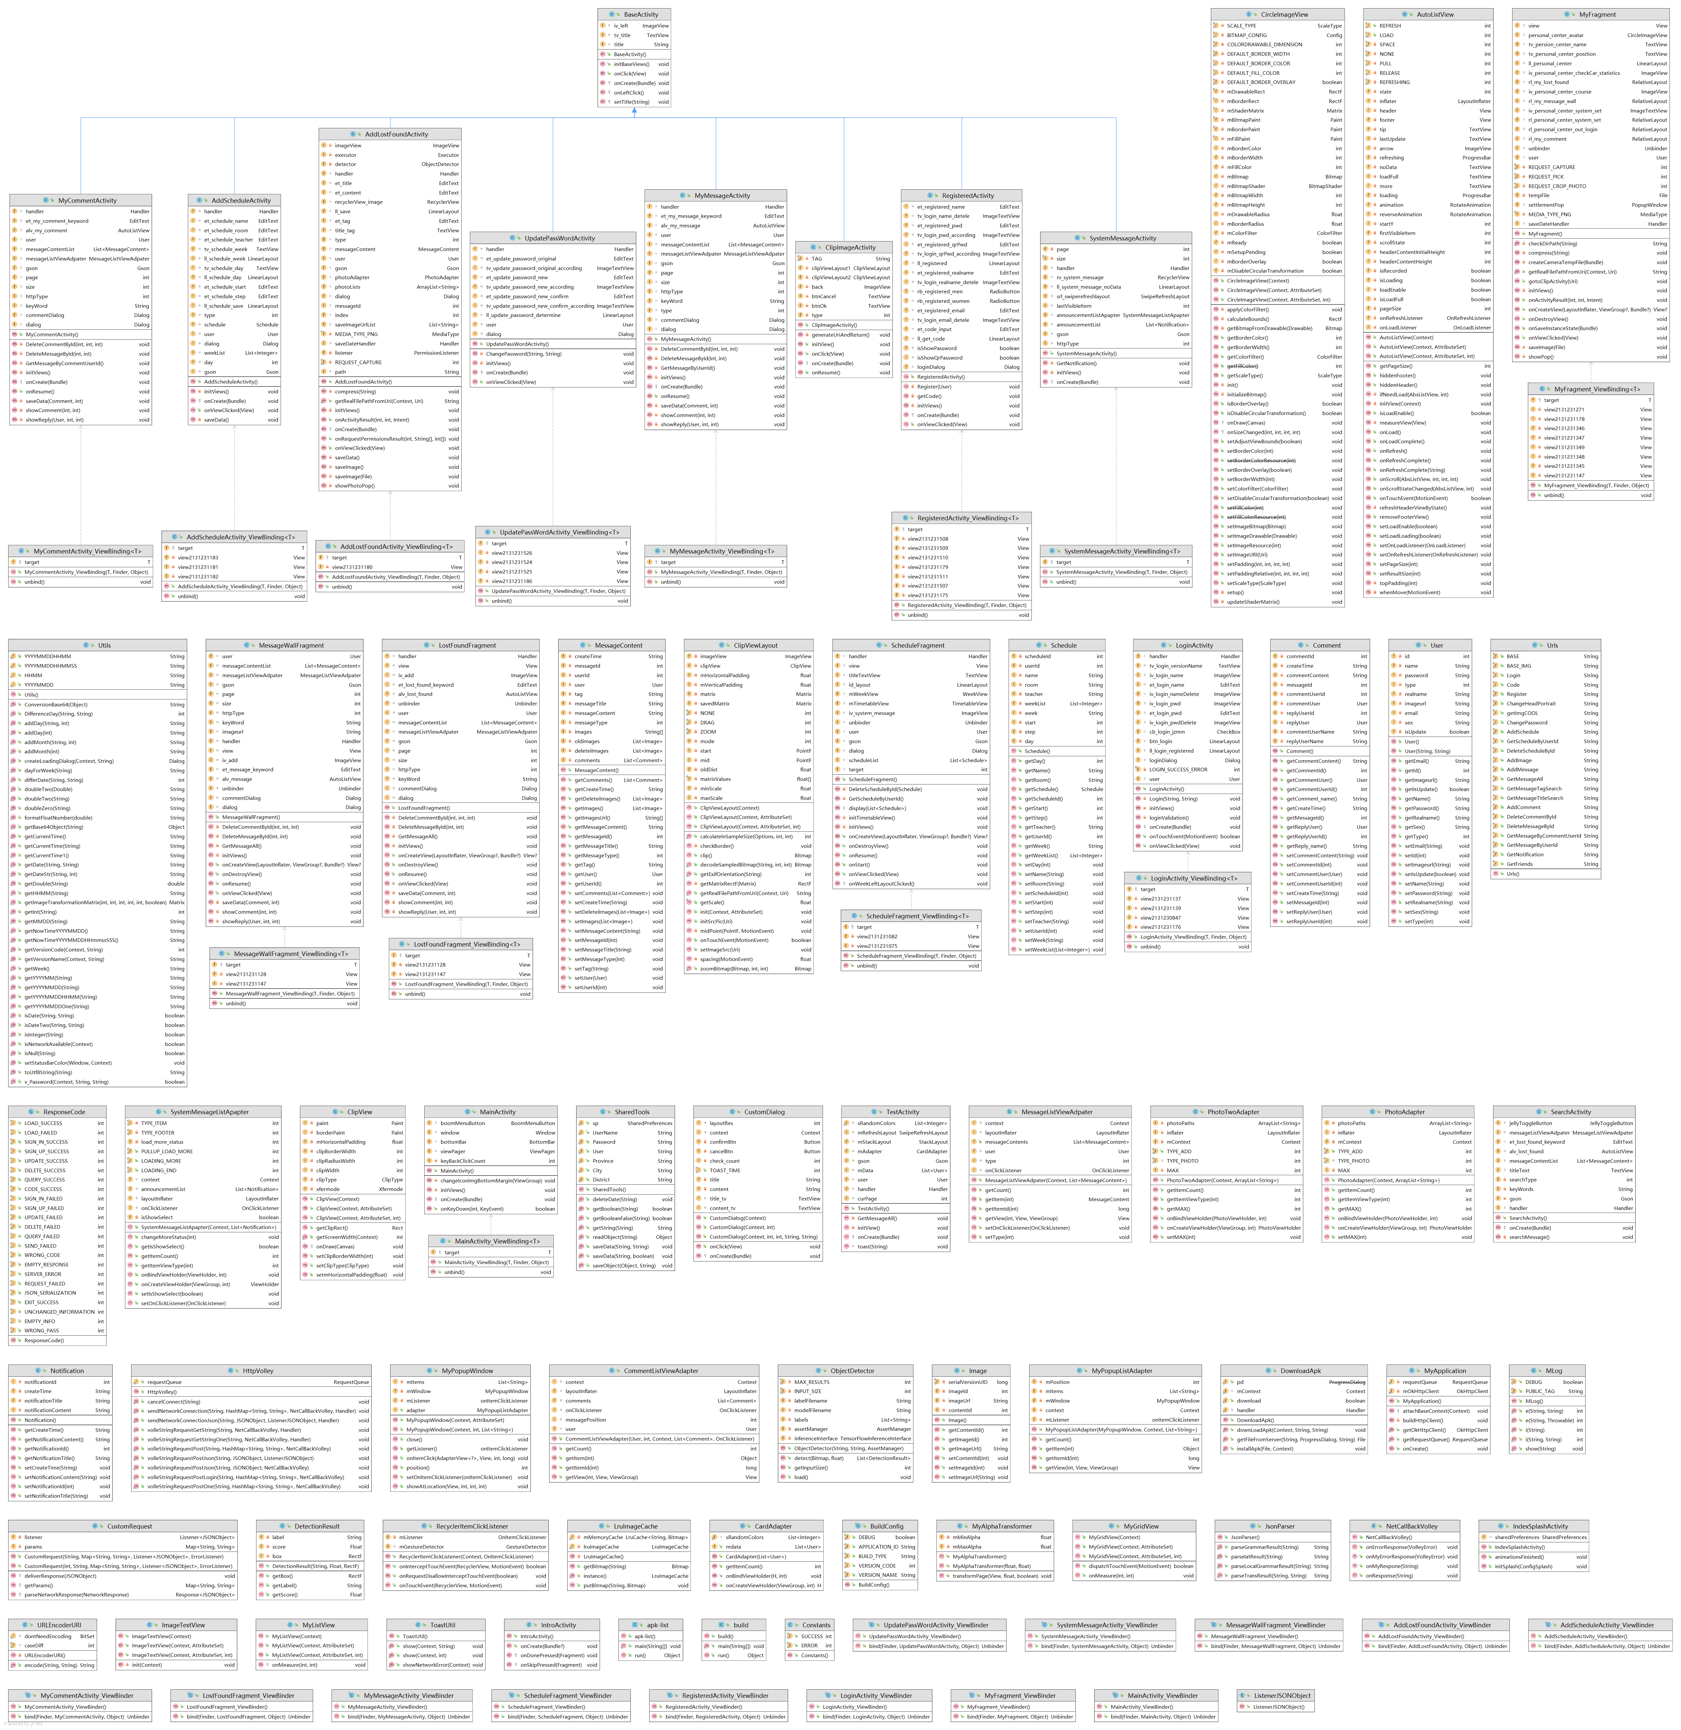
CLASS GRAPH
SUPER CAMPUS
HOME
INTRO
FUNCTION
DIFFICULTY
DEMO

Slide 19
CLASS GRAPH
SUPER CAMPUS
HOME
INTRO
FUNCTION
DIFFICULTY
DEMO

Slide 20
CLASS GRAPH
SUPER CAMPUS
HOME
INTRO
FUNCTION
DIFFICULTY
DEMO

Slide 21
CLASS GRAPH
SUPER CAMPUS
HOME
INTRO
FUNCTION
DIFFICULTY
DEMO

Slide 22
CLASS GRAPH
SUPER CAMPUS
HOME
INTRO
FUNCTION
DIFFICULTY
DEMO

Slide 23
SUPER CAMPUS
IMPELEMENT DETAILS
HOME
INTRO
FUNCTION
DIFFICULTY
DEMO

Slide 24
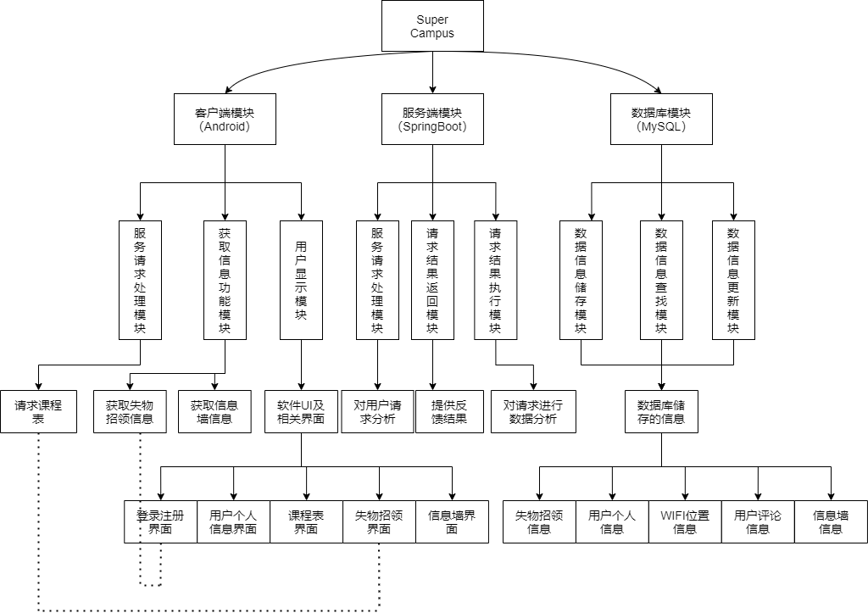
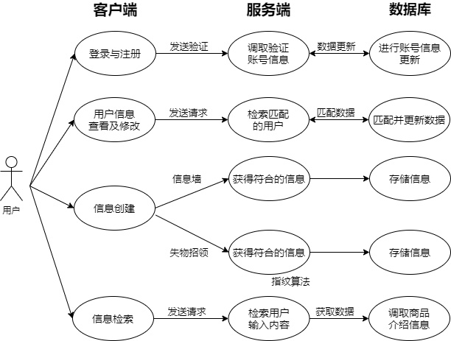
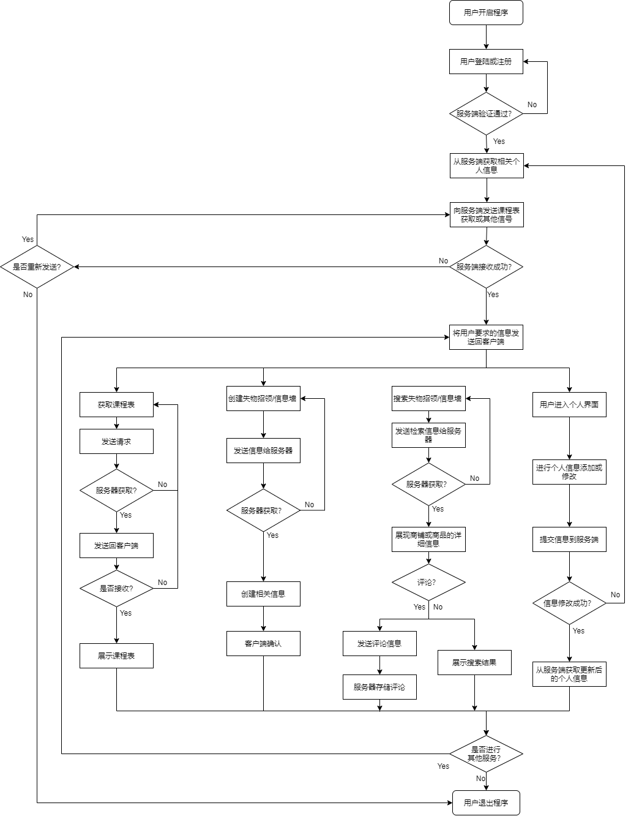
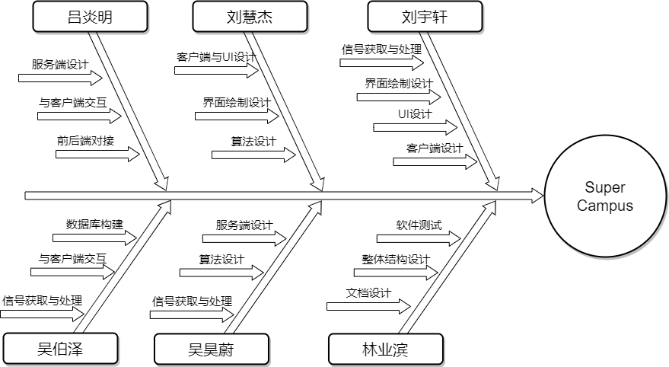
FLOW CHART
SUPER CAMPUS
HOME
INTRO
FUNCTION
DIFFICULTY
DEMO
USE-CASE
DIVISION
GRAPH

Slide 25
SUPER CAMPUS
04
DEMO PRESENT
HOME
INTRO
FUNCTION
DIFFICULTY
DEMO

Slide 27
SUPER CAMPUS
THANKS!

